Slide 1
Interdisciplinary Infusion of Number
Chris Jones & Emily Marsden

Slide 2
Math Standard and Grade Level
First Grade Mathematics: Standard 1: Number and Quantity.
1.NBT.A. Number & Operations in Base Ten: Extend the counting sequence Evidence Outcomes: -Students can count to 120, starting at any number less than 120. -In this range students can read and write numerals and represent a number of objects with a written numeral. | 1.NBT.B.B. Number & Operations in Base Ten: Understand place value. Evidence outcomes: Students can understand that the two digits of a two-digit number represent amounts of tens and ones. Understand the following as special cases: 10 can be thought of as a bundle of ones called a “ten” Numbers 11-19 are composed of a ten and a 1,2,3,4,5,6,7,8,9 ones The numbers 10,20,30,40,50,60,70,80,90 refer to 1,2,3,4,5,6,7,8,9 ‘tens’ Students can compare two two-digit numbers based on meanings of the tens and ones digits, recording the results of comparisons with the symbols >,=,<

Slide 3
Math Standard and Grade Level cont.
Overview of 2 weeks:
Week 1 | Week 2
1.NBT.A. Number & Operations in Base Ten: Extend the counting sequence Informal Assessment: Task Group A3.1 - Forward Number Sequences Activities: Toy Box (Adapted from IA 4.7, Teaching Number) Race to 120 Jack Hartman Counting Videos Hallway Teaching: Count Around (Adapted from IA 3.1) What Comes Next? (Adapted from IA 3.4) Counting to line up Performance Task: Students will create piece of art using a numeral between 100-120. Students will then work together to organize these numerals in the appropriate order on the wall. | 1.NBT.B.B. Number & Operations in Base Ten: Understand place value. Informal Assessment: Task Group A8.4 - Incrementing and Decrementing by Tens on and off the Decuple Activities: Bead String with Ten Catcher Greater Than, Less Than, Equal to Game Place Value and Comparing Numbers Videos Hallway Teaching: I’m thinking of a number… More or Less? What Number am I? Performance Task: Students will create a poster that includes writing and use of number Students will use this poster to compare two different animals using knowledge of place value and comparing two digit numbers using <, =, >

Slide 4
Week 1: Number & Operations in Base Ten: Extend the Counting Sequence
Evidence Outcomes:
-Students can count to 120, starting at any number less than 120.
-Students can read and write numeral and represent a number of objects with a written numeral within this range.

Slide 5
Informal Assessment
Task Group A3.1 (Teaching Number): Forward Number Word Sequences (Counting to 120)
Directions: Teacher meets with students one-on-one in a seated, quiet area. The teacher tells the student they are going to start counting from 95 and that they will tell the student when to stop counting (120).
Considerations:
Teacher should pay attention to students transitions to the next decade and when transitioning from 99 to 100.
Listen for pronunciation of numbers, for easily confused numbers.

Slide 6
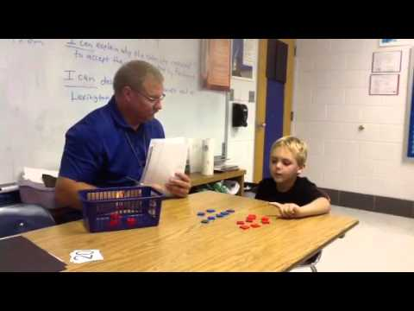
Informal Assessment (Continued)
Differentiating:
Counting may be adjusted for students still working in the range of 1-100. These students may start at 70 and count on from there.
Counting sequence may be extended to see how far a student is able to go past 120
If easier for student they may write numerals in order using a blank numeral ladder, or blank 120 chart.
Watch:
-This video demonstrates many 1st grade math assessments, the first of which demonstrates assessing for counting forward. (Although in this video the student is only counting to 20, we can see how to transfer this to counting to 120)

Slide 7
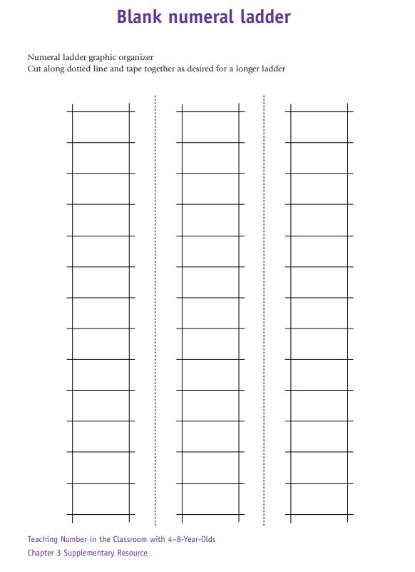
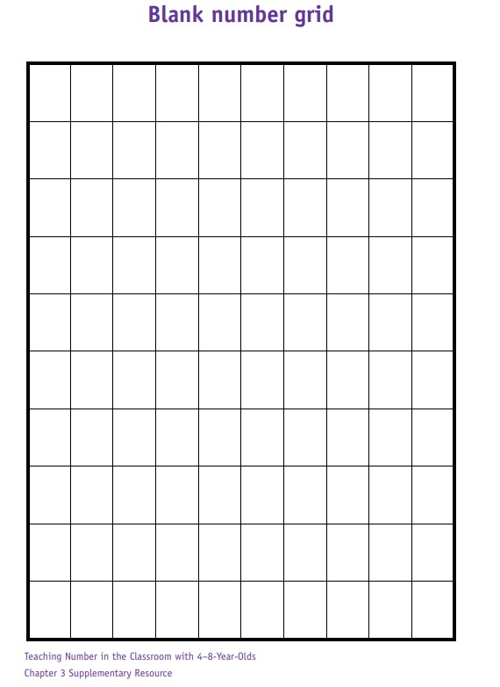
Informal Assessment (Continued)
Materials Needed: Blank Numeral ladder, blank number grid, pencil

Slide 8
Activities

Slide 9
Activity 1: Toy Box (Adapted from Activity IA4.7)
Objective: To represent numerals and a number of objects in the range of 100-120 with a written numeral.
Materials Needed: A collection of toys or objects, a box or bag, white boards, dry erase markers, erasers, and one die.
Description: The teacher has a collection of small objects they can place in the box. The teacher tells the students there are 100 marbles in the box. The teacher tells the students they have a 6-sided die and they are going to count that number of marbles into the box based on the number on the die. After rolling the teacher asks the students to write on their white board the number of marbles total in the box. The teacher can repeat this, starting with any number between 90-120.

Slide 10
Activity 1: Toy Box (Continued)
Differentiating:
Below Grade Level:
-To support students that our still working in the range of 1-100, this activity can be adjusted to this range.
-A die with only the numerals 0, 1, and 2 could also be used to work with counting smaller units
-Students can be paired, with one white board per pair, for peer scaffolding
Above Grade Level:
-To further challenge students the starting number can be extended beyond 120.
-To further challenge students two six-sided dice can be rolled.
-To further challenge students counting back could also be integrated.

Slide 11
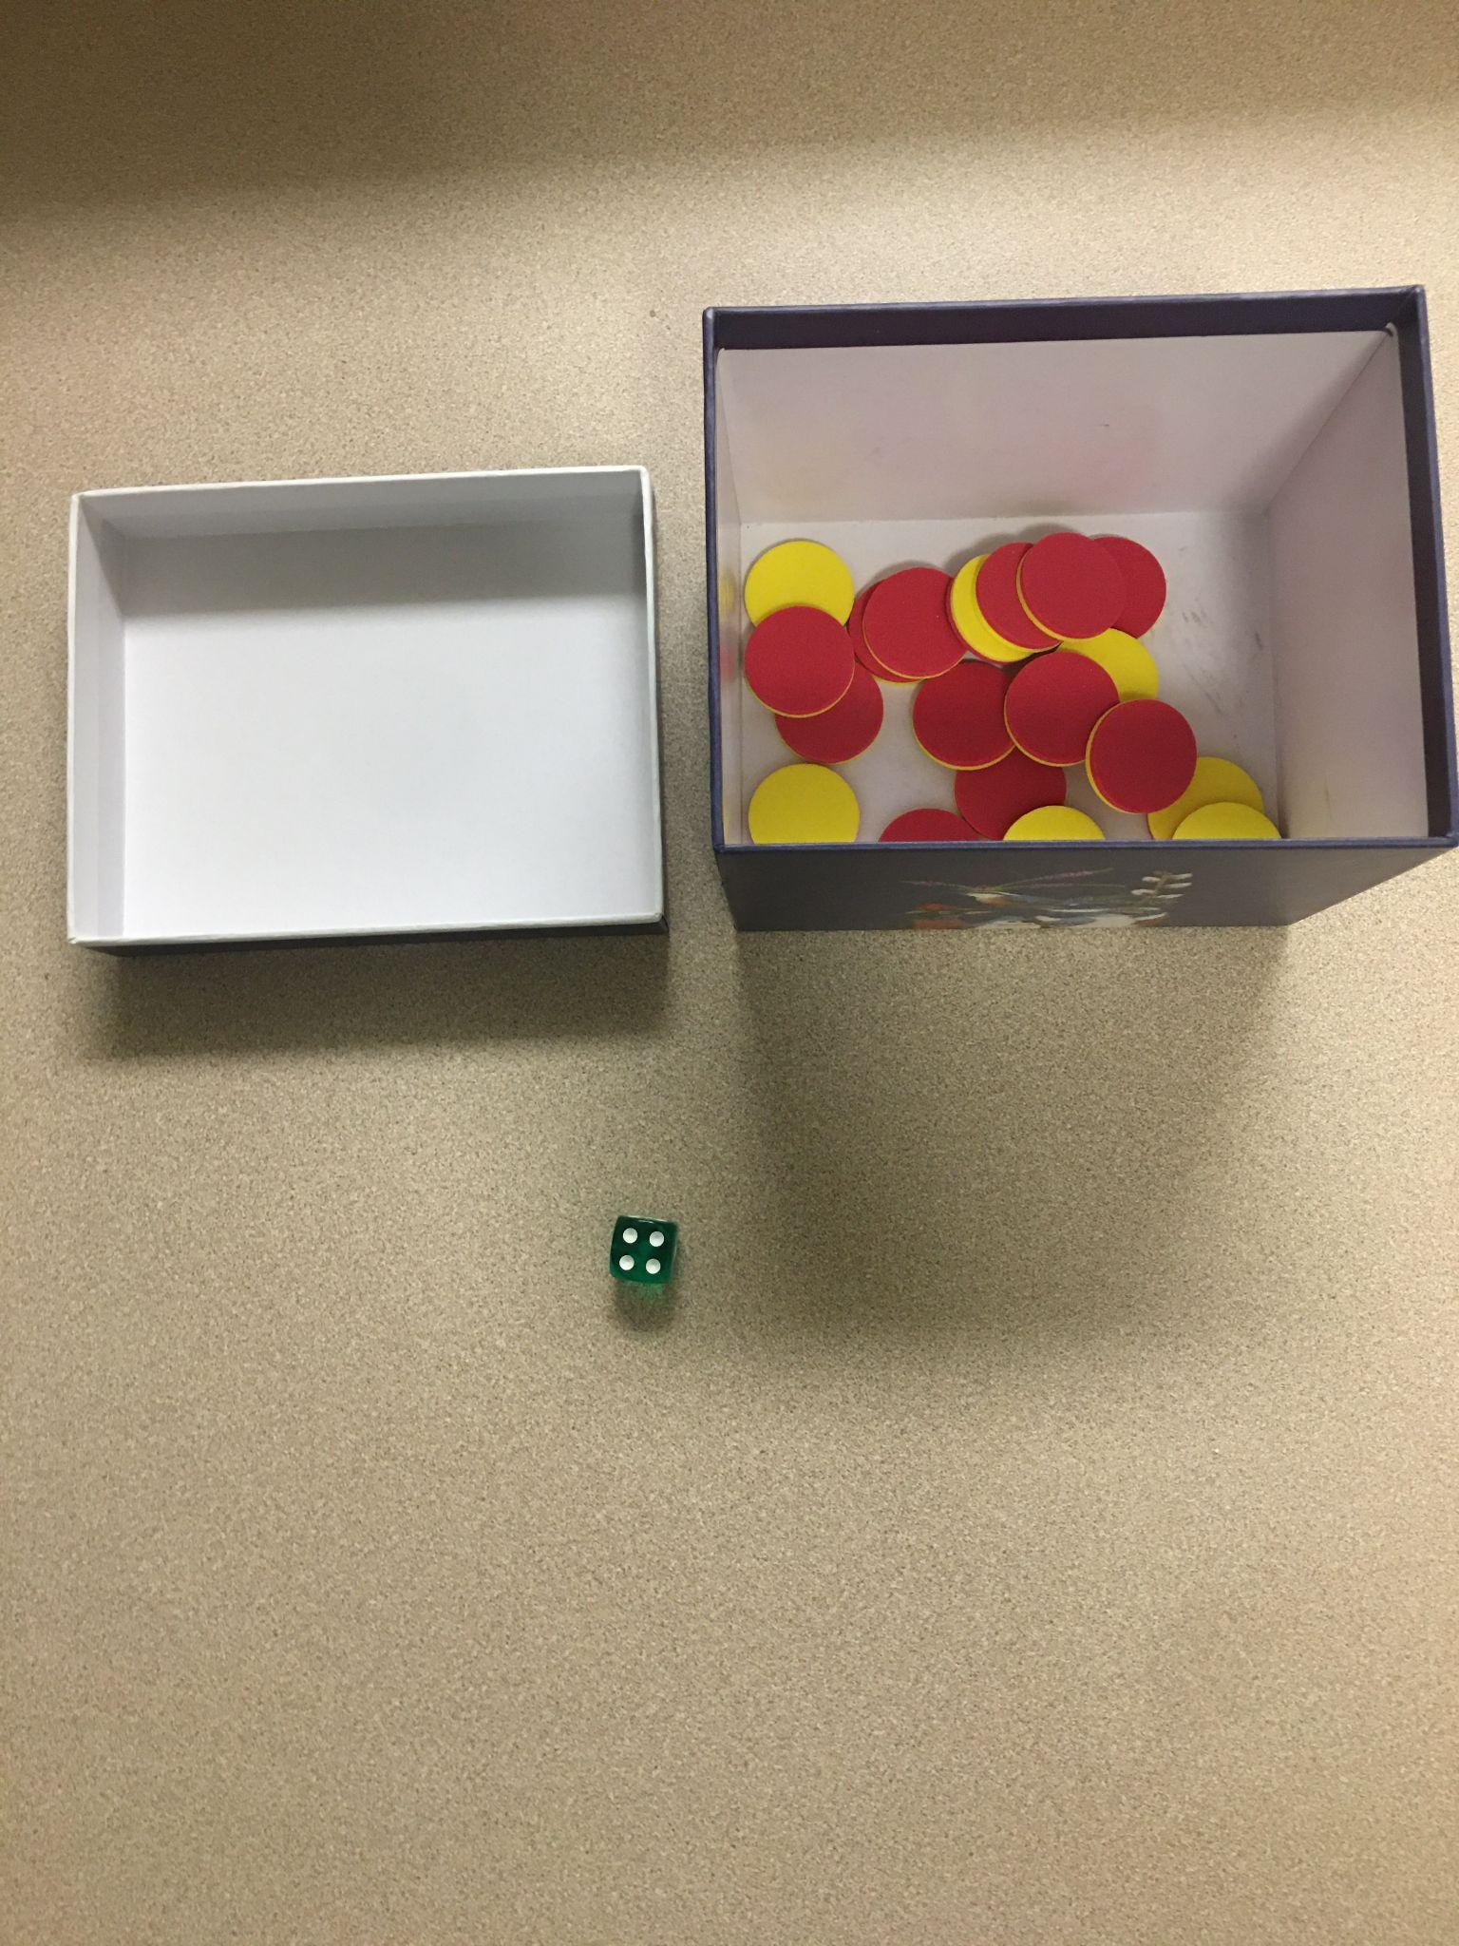
Activity 1: Toy Box (Demonstration)
 | After rolling a 4 the teacher would add 4 of the tokens based on the direction, they gave the students before rolling the die. If the teacher told the students that there were 116 tokens in the box and they are counting up 4, an answer of 120 would be written by the students on their white boards.

Slide 12
Activity 2: Race to 120
Objective: To gain fluency with counting to 120 in different increments as dictated by the roll of the dice
Materials Needed: Enough copies of 120’s charts for every student, crayons, 2 six-sided dice per group
Description: This game is to be played in pairs. The teacher will explain the directions before students move into their paired groups to play the game. Each student will have their own 120 chart and a crayon. Each pair of students will have a pair of six-sided dice.
Starting at the beginning of their 120 chart, students will take turns rolling the dice and adding the numbers they rolled. If the students roll an 8 for example, they will color in the boxes up to and including the number 8. Then when that student rolls a 9 next turn, they will have colored up to and including the number 17. The game continues until one student has colored in all 120 of the boxes on their chart.

Slide 13
Activity 2: Race to 120 (Continued)
Differentiating:
Below Grade Level:
-To support students that our still working in the range of 1-100, this game can use a 100 chart instead of a 120 chart
-Students can use one die instead of 2
-Students can be paired for peer scaffolding by pairing students above and below grade level together
Above Grade Level:
-To further challenge students the starting number can be extended beyond 120.
-To further challenge students they could start at 120 and subtract the numbers on their dice until they make it back to the beginning

Slide 14
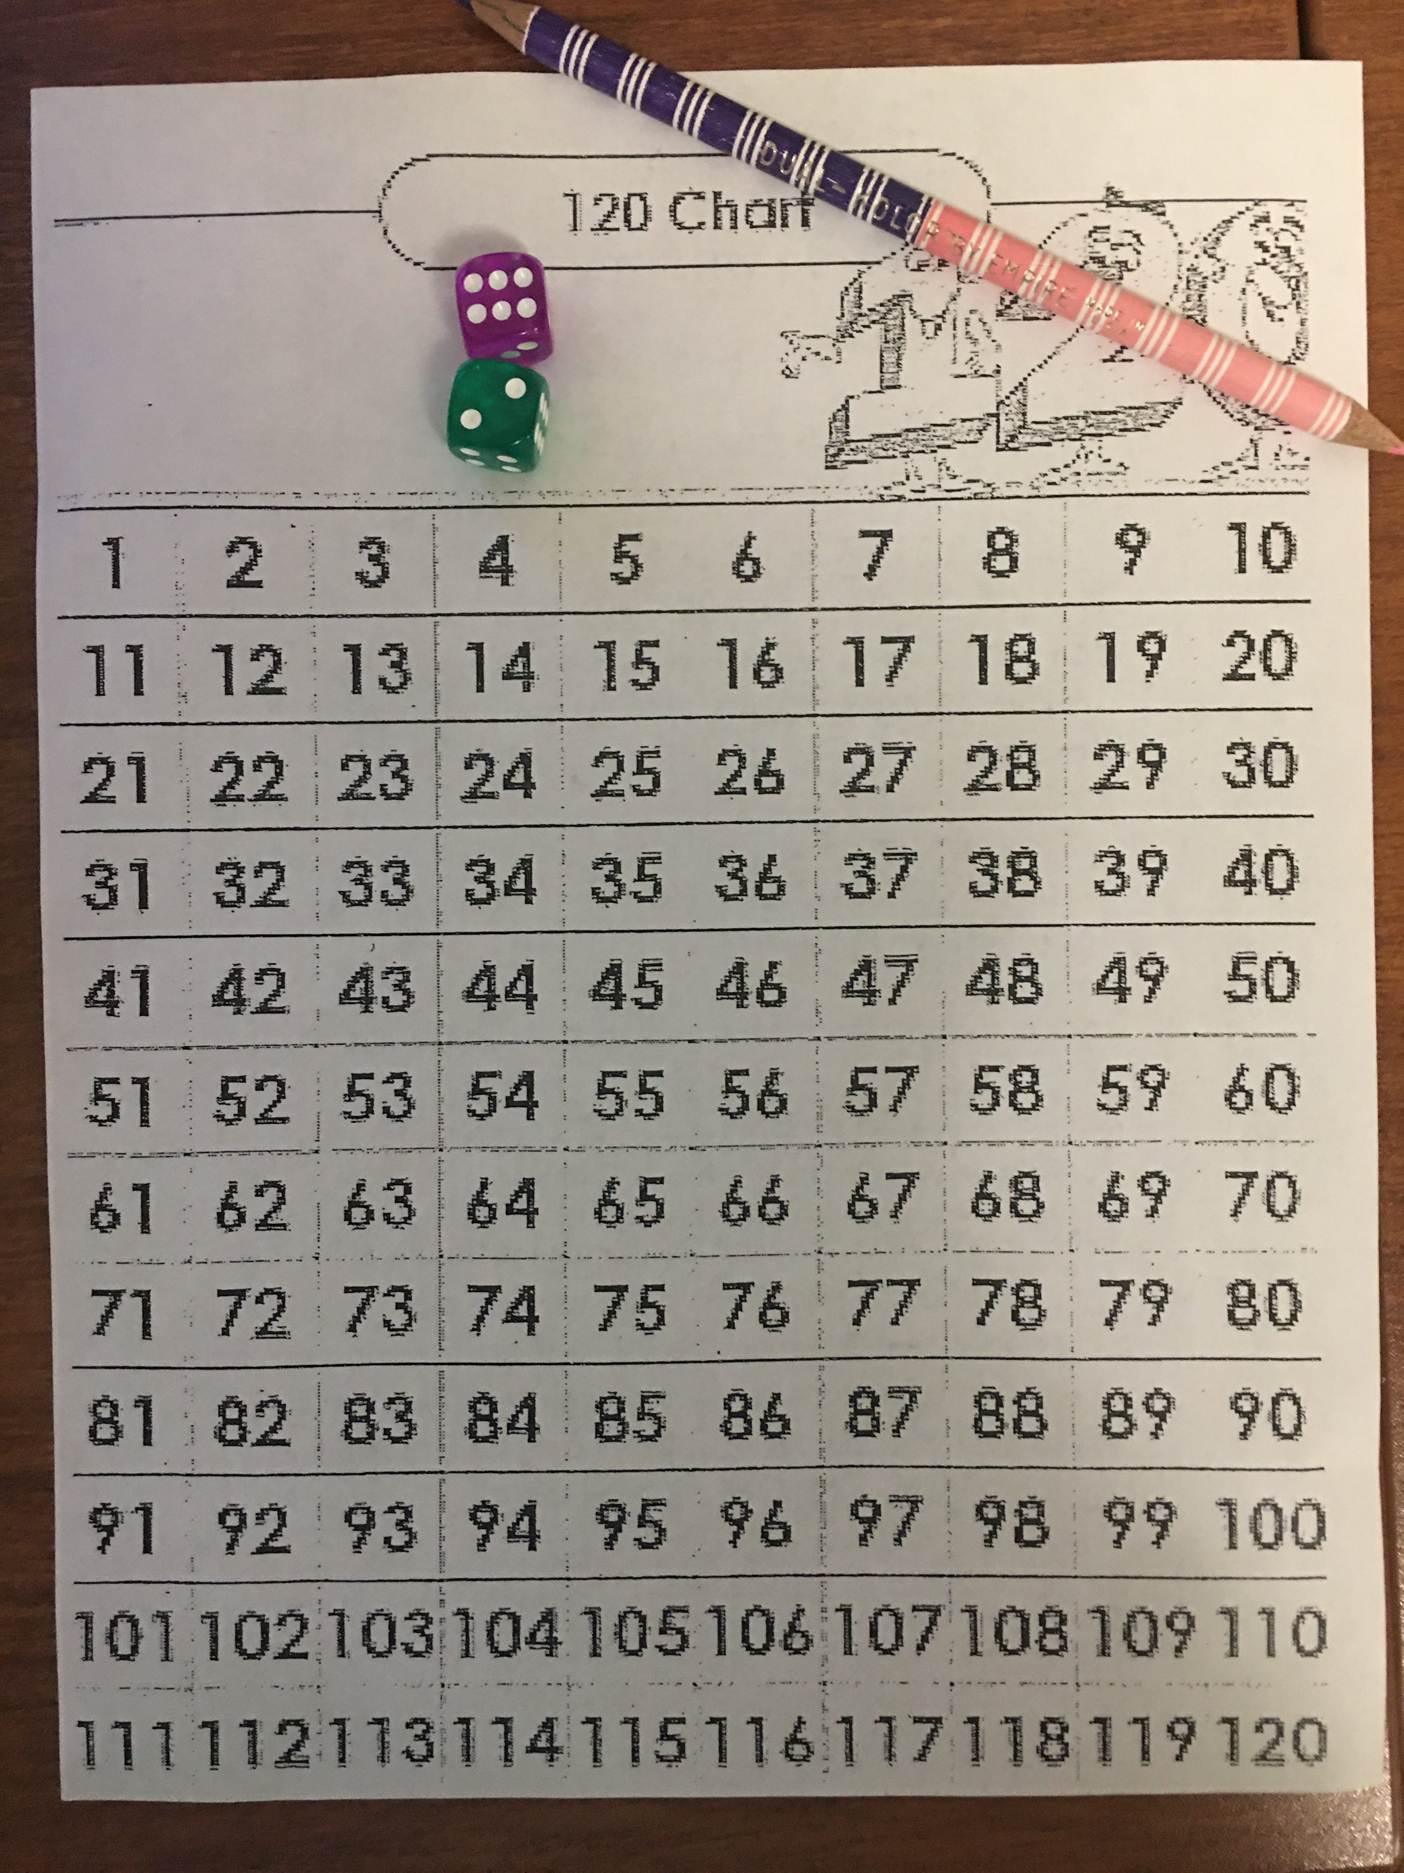
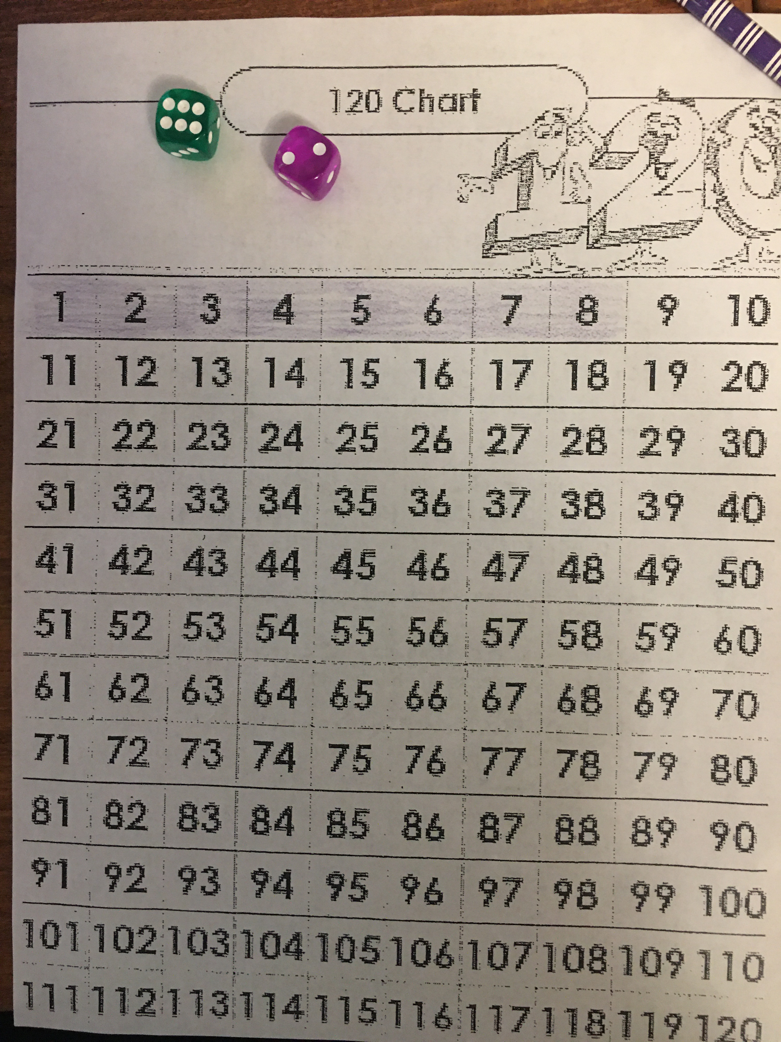
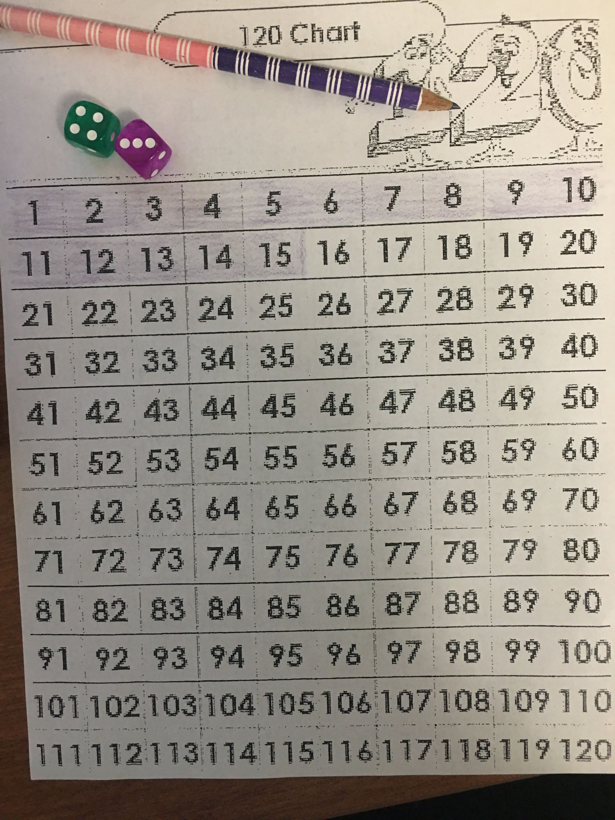
Activity 2: Race to 120 (Continued)
Setting Up | Roll #1 = 8! | Roll #2 = 7! (15 Shaded in)

Slide 15
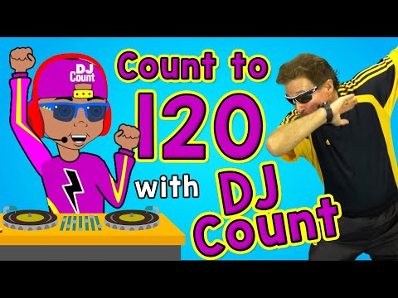
Activity 3: Jack Hartman, Count to 120
Objective: Students gain fluency with counting to 120, counting by 1’s and 10’s
What is Needed: Internet Access, Smartboard/Projector Screen, seating arrangement for all students to see video and have space to move
Videos:
Description: These videos provide students with catchy rhythms/music and movements to follow along with as they count to 120 by 1’s in the first video and then count by 10’s to 120 in the second video. The first video is about 5 minutes and the second 3 minutes. They could be integrated one 10 minute activity, or be broken up to be used on different days. The students should be encouraged to follow along vocally and participate in the movements as well. The teacher should also model participation.

Slide 16
Activity 3: Jack Hartman, Count to 120 (Continued)
Differentiating:
Jack Hartman math videos can be easily differentiated for below or above grade level. He has videos that count to 100, as well as to 150.
He also has counting videos with different themes, to match to students interests.

Slide 17
Hallway Teaching Moments

Slide 18
Hallway Teaching Moment #1
Count Around to 120 (Adapted from IA 3.1, Teaching Number)
Objective: Fluency with counting forward up to 120
Procedure: While students are waiting in line teacher starts with a number within the range of 80-120 and asks students count on by 1’s moving down the line.
To adapt teacher may start a count that will stay in the 1-100 range
To extend teacher may go beyond 120
To extend teacher may skip count by 2, 5, 10, etc.

Slide 19
Hallway Teaching Moment #2
What Comes Next ? (Adapted from Teaching Number, pg. 43)
Objective: Fluency counting forward in the rage of 1-120
Procedure: Teacher begins counting (ex. 95,96,97,98,99,100…..) and then stops on a number (in this case 100) and asks students what number comes next? Teacher can repeat this activity starting and stopping at different numbers in the range of 120 as time allows.
-This activity can be adapted to the 1-100 range
-Extended to count beyond 120
-Extended by using skip counting

Slide 20
Hallway Teaching Moment #3
Counting to Line Up
Objective: Fluency counting forward in the rage of 1-120
Procedure: As teacher asks students to line up to leave the classroom they give the first student the number of 100. They then ask each student that lines up after them to count on (so the second student in the line would be 101, 3rd student would be 102, and etc.)
-This activity could be adapted to the range of 1-100
-Extended to go beyond 120
-Extended to use skip counting

Slide 21
Interdisciplinary Craft/Performance Task
Art with numbers between 100-120
Art Standard: First Grade, Standard 3. Invent and Discover to Create. Grade Level Expectation: 1. Investigate the properties of materials to support the planning and making of works of art to communicate.
Art Evidence Outcomes: Students can choose art media to express ideas and feelings, describe the steps used in creating art, and share materials with intention and care.
Math Evidence Outcomes:
-Students can represent a numeral in written form in the range of 100-120.
-Students can work as a group to count forward from 100-120 when organizing their art on the wall in the correct order.

Slide 22
Interdisciplinary Craft/Performance Task (Continued)
Description: Each student in the class with be responsible for creating an art piece incorporating one of the numerals in the range of 100-120. Students will have creative flexibility with how they decide to represent their number in their art, but every student must have their written numeral on their art piece. After every student has completed their art piece the students will work together to place them on a designated wall in the classroom in the correct order.
Materials Needed: Craft paper, markers, colored pencils, colorful scrap paper, glue, scissors, and other craft items the teacher has readily available (this art project can resourcefully use a lot of scrap materials in the classroom).

Slide 23
Interdisciplinary Craft/Performance Task (Continued)
Differentiation:
Below Grade Level:
-Students working with numbers in the 1-100 range may work on numbers in the 90-99 range for this task (so that it would still create a continuous line of numbers with students working in the 100-120 range)
-Students could work with digital art platforms on chromebooks if available if they have challenges with handwriting
Above Grade Level:
-Students could be challenged to show a visual depiction of their number in their artwork (ex. Drawing a 110 marbles)
-Peer scaffolding: Students can work in pairs to create to pieces of art (two numerals) with a student below and above grade level working together

Slide 24
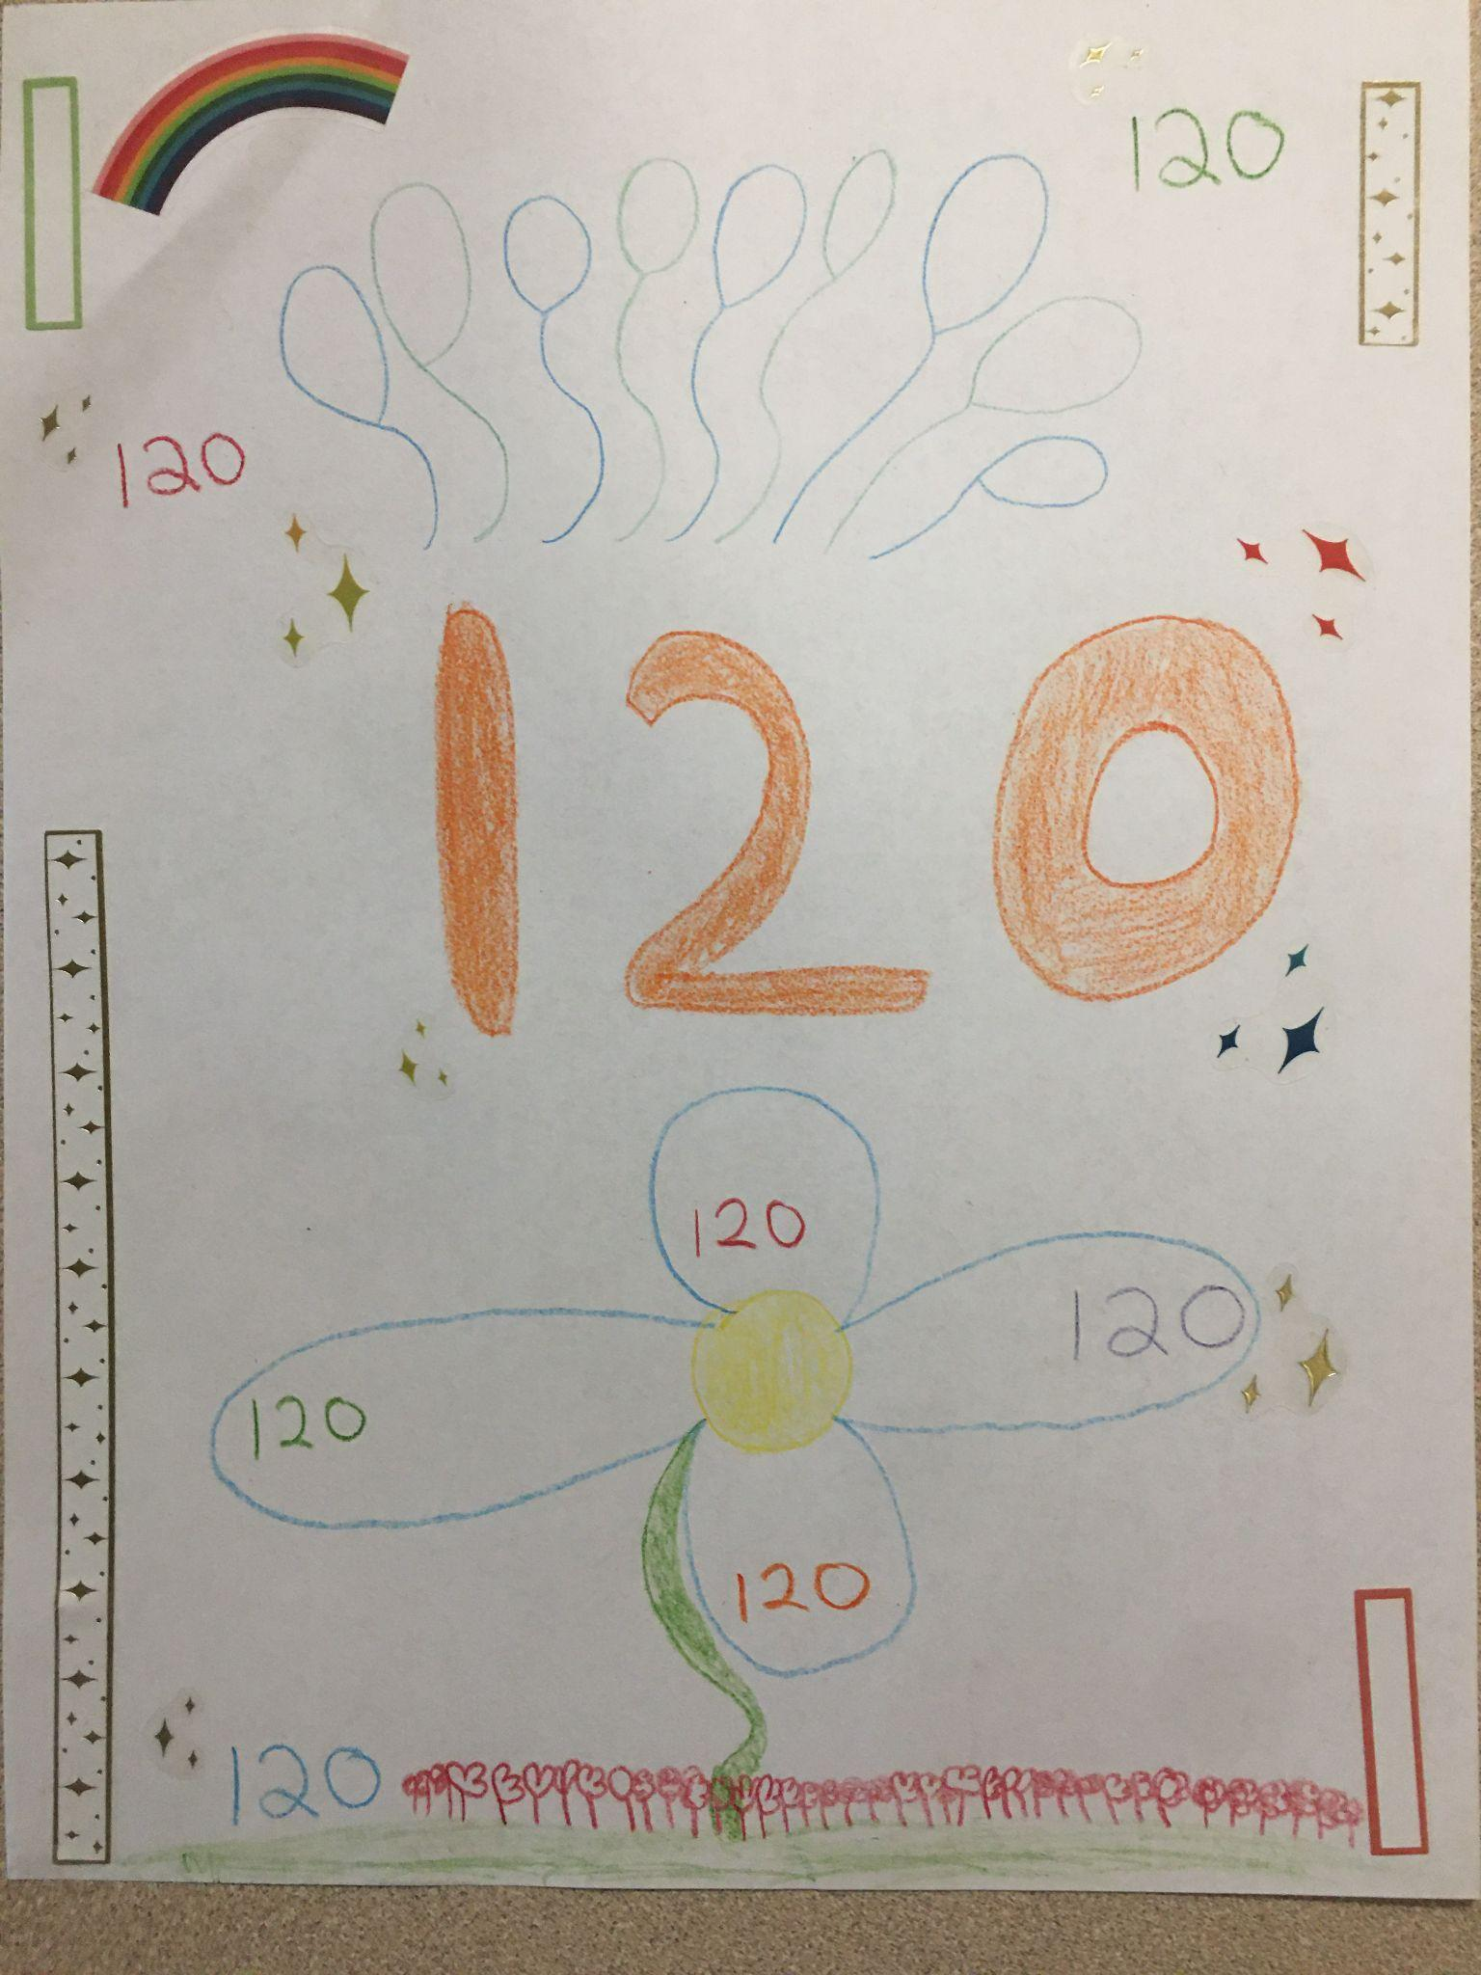
Interdisciplinary Craft/Performance Task (Continued)
Exemplar:

Slide 25
Week 2
Number & Operations in Base Ten: Understand place value.
Target/Evidence Outcomes:
Students can understand that the two digits of a two-digit number represent amounts of tens and ones.
Students can compare two two-digit numbers based on meanings of the tens and ones digits, recording the results of comparisons with the symbols >,=,<

Slide 26
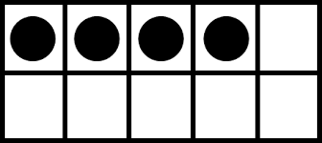
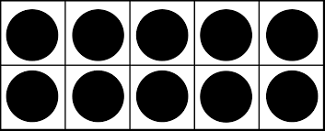
Informal Assessment: Incrementing and Decrementing by Tens and off the Decuple, Task Group A8.4
Materials: Ten-strips (Strips of cardboard containing 10 dots- 5 black,5 grey), four-strips (like a ten strip but with only four dots and so on), a screen.
Procedure:
Incrementing on the Decuple
Place out three ten strips and ask student, “How many dots are there?” and “How many tens are there?”
Screen the ten strips. Place an additional ten strip under the screen and ask student, “How many dots are there now?” and “How many tens are there?”
Continue to 100 adding one or two ten strips at a time.
Decrementing on the Decuple
Place out nine ten strips and ask student, “How many dots are there?” and “How many tens are there?”
Screen the nine ten strips. Take out one ten strip from under the screen and ask again, “How many dots are there?” and “How many tens are there?”
Continue down to 0

Slide 27
Informal Assessment Procedure cont.
Incrementing off the decuple
Place out two ten strips and a four strip. Ask the student, “How many dots are there?”
Screen the 24 dots and place another tens strip under the screen. Ask, “How many dots are there now?”
Continue up to 104, adding one or two ten strips at a time
Decrementing off the decuple
Place out nine tens strips and a six strip. Ask the student, “How many dots are there?”
Screen the 96 dots and take out one ten strip from under the screen. Ask, “How many dots are there now?”
Continue down to 6, taking one or two ten-strips at a time
Notes:
Observe to see if the student is counting by ones (EX: 30 and 10 more → 30,31,32,33,34, etc.)
Children who use counting by ones are likely to use their fingers to keep track of ten counts.

Slide 28
Informal Assessment cont.
Differentiated
Above Grade Level:
To support students who are performing above grade level, the assessment can be made more challenging by having the student switch from counting up by tens to counting by ones and back. (EX: instead of placing tens under the screen each time, the teacher can place a ten one time, and a four the next, then a ten again: 10,14,24,28,etc.)
Below Grade Level:
To support students who are performing below grade level, the assessment can be made less challenging by not using the screen to cover the strips. This way, students can continue to see the entire collection after more has been added/taken away.

Slide 29
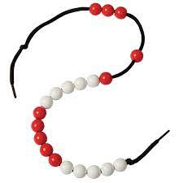
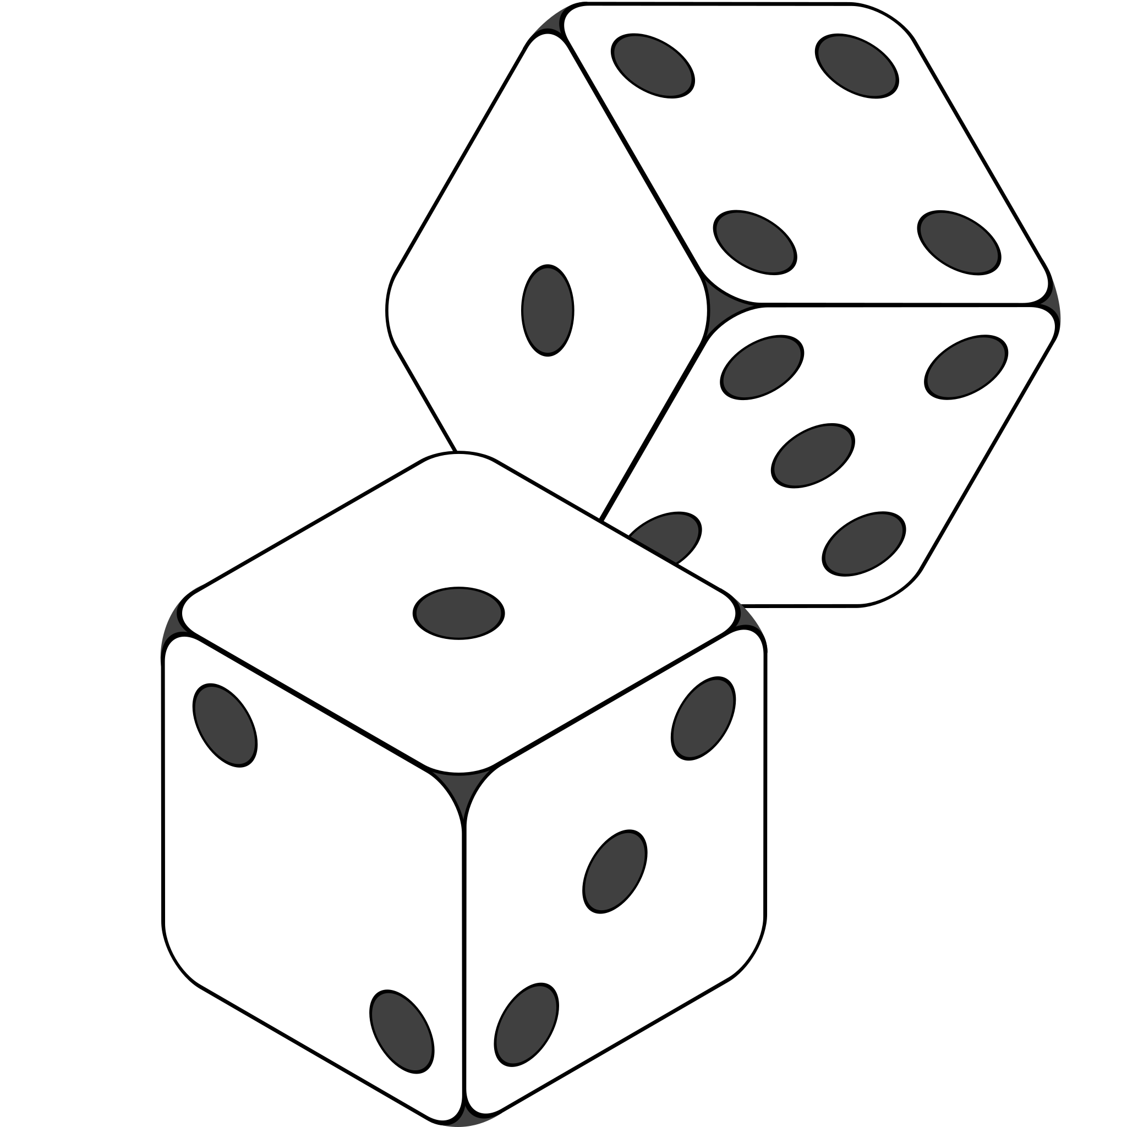
Activities

Slide 30
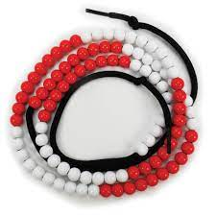
Activity 1:
Activity IA8.2: Bead String with Ten Catcher (Teaching Number, pg. 149)
Intended learning: Adding ten and tens to any number
Materials: String of 100 beads in alternating colors of lots of ten, tube or cloth to cover, chalk or white board for recording strategies.
Procedure:
Use with students in small groups or whole class.
Show the students the first collection of beads (10 red beads) then cover it with a cloth. Ask, “How many beads are there?” (10)
Slide a second collection of beads next to the first, but leaving it uncovered. Ask “How many beads are there in all” (20). “How did you know?”
Listen to the strategies each student used to get 20 beads in all and record on the white board.
Continue to add or subtract collections of beads.

Slide 31
Activity 1: cont.
Differentiated Instruction:
Above Grade Level:
To support students who are demonstrating skills above grade level, both collections can be screened/covered before asking how many there is and how they know. Additionally, several collections at once can be added to the groups to make it more challenging.
Below Grade Level:
To support students who are demonstrating skills below grade level, the teacher can put the screen away and just have students look at both collections at one time to figure out how many there are.

Slide 32
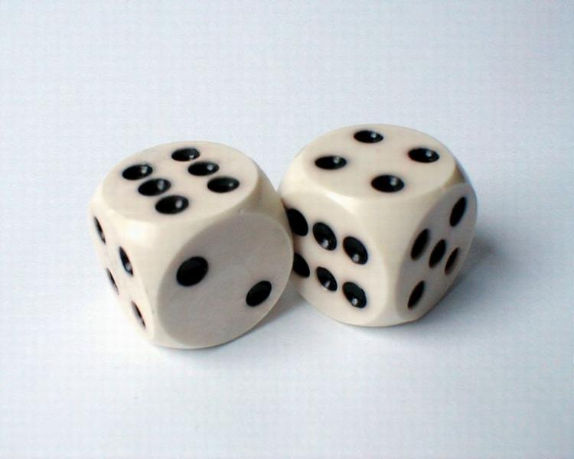
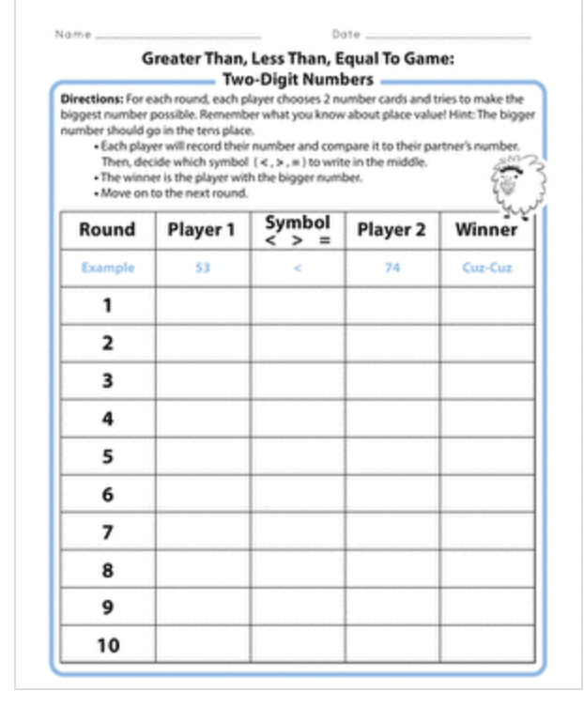
Activity 2:
Greater than, less than, equal to game
Intended Learning: Comparing two digit numbers using the greater than, less than, and equal to signs.
Materials: Two dice, worksheet
Procedure:
Get students into pairs of two and provide them with two dice and a worksheet.
Explain that the pair will take turns rolling the two dice in order to get a two digit number to record on the worksheet. (EX: roll one dice- 3, roll the next dice-6, your number is 36)
The students will look at each of their numbers and decide together which number is greater. They will record the correct symbol on the worksheet and then record who won the round.
Winner= who has the greater number
https://www.education.com/worksheet/article/greater-than-less-than-equal-to-game-two-digit-numbers/

Slide 33
Activity 2: cont.
Differentiated Instruction:
Above Grade Level:
To support students who are demonstrating skills above grade level, this game can be changed to rolling the dice three times in order to get numbers in the 100s place.
Below Grade Level:
To support students who are demonstrating skills below grade level, this game can be changed to use only one dice in order to make numbers in the ones place. Further, students who are struggling with the concept of more, less, and equal to can circle the bigger number until they are comfortable with the concept of the symbols <,>,=.
134 < 145
9 3

Slide 34
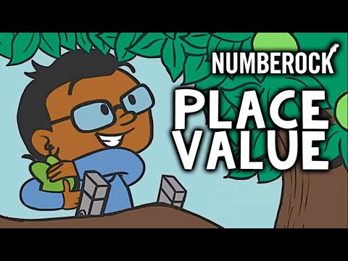
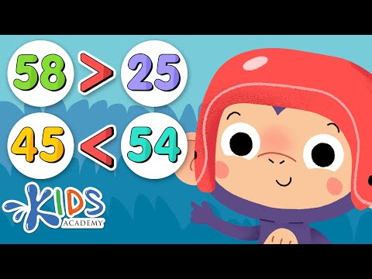
Activity 3:
Place Value and Comparing Numbers Videos

Slide 35
Activity 3: cont.
Intended Learning:
Video 1: Understanding place value and counting by 10s
Video 2: Comparing two digit numbers using <,>,= signs.
Materials: Internet access, a projector or smartboard, whiteboards/ markers
Procedure:
Have students sit somewhere where they can all see the videos.
Both videos can be played during the same lesson or can be spread out into two separate lessons. (Video 1= 3:55 minutes) (Video 2= 15:46 but can be stopped at 3:50).
Video one can be played as a review for the class about what it means to have numbers in the tens or ones place.
Video two then can be played to learn about how to use the tens and ones place to compare two numbers to find the biggest.
To make the video interactive, pause the video and have the students write the answer to the greater than/less than questions on white boards. Unpause the video to see if they got the right answer.
32 > 12

Slide 36
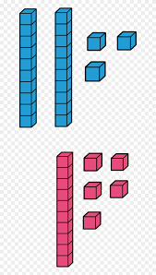
Activity 3: cont.
Differentiated Instruction:
Above Grade Level:
To support students who are demonstrating skills beyond grade level, you can provide them with additional problems to solve, or ask them if the symbol would change by adding a number or taking a number away. (EX: 58 > 25 but if I added a 1 to the beginning of both (158 ___ 125) , would the sign change? If yes, why?
Below Grade Level:
To support students who are demonstrating skills below grade level, base ten blocks can be provided in order to provide an additional manipulative/visual for students to answer the questions. For students who need more support, the video can be watched and followed along with without the use of manipulatives or white boards.

Slide 37
Hallway Teaching Activities

Slide 38
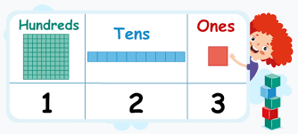
Hallway Teaching Activity 1:
I’m Thinking of A Number…
Intended learning: Understanding place value (10s and 1s)
Materials: NONE!
Procedure:
Tell students that you are going to give them clues and they will need to guess the number that you are thinking of.
Tell the students, “I’m thinking of a number that has 1 ten and 4 ones.” (14)
Another version of this activity can be done by giving students a whole number and asking them for how many tens, and ones the number has.
Use higher place values as students get better at identifying tens and ones.

Slide 39
Hallway Teaching Activity 2:
More or Less?
Intended Learning: Understanding the concept of more, less, and equal to.
Materials: NONE!
Procedure:
Show students how to show more, less, or equal to on their hands. (thumbs up= more than, thumbs down=less than, thumb to the side= equal to)
Tell students “23 is ‘blank’ than 12”. Students should give a thumbs up showing that they understand 23 is more than 12.
Repeat with different numbers.

Slide 40
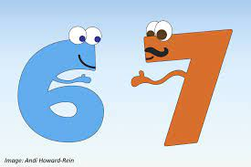
Hallway Teaching Activity 3:
What Number am I?
Intended learning: Understanding place value and the concept of more or less.
Materials: NONE!
Procedure:
Explain that you are going to give the students clues to what number you are and they have to guess.
Pick a number (73) and begin with a couple of clues like, “I have two digits (or numbers). I am more than 60, but less than 80. The number in my ones place is less than 5.”
Have students begin guessing numbers, and retell clues if they get off track. Give more and more clues until one student guesses correctly.
Game can be made easier by adding bigger/ more obvious clues like, “I have one digit that is more than 5” or “I have two digits that are more than 20 but less than 30”

Slide 41
Performance Task

Slide 42
Interdisciplinary Performance Task
Standards:
First Grade Mathematics: Standard 1: Number and Quantity
1.NBT.B.B. Number & Operations in Base Ten: Understand place value.
Evidence Outcomes:
Students can understand that the two digits of a two-digit number represent amounts of tens and ones. Understand the following as special cases:
10 can be thought of as a bundle of ones called a “ten”
Numbers 11-19 are composed of a ten and a 1,2,3,4,5,6,7,8,9 ones
The numbers 10,20,30,40,50,60,70,80,90 refer to 1,2,3,4,5,6,7,8,9 ‘tens’
Students can compare two two-digit numbers based on meanings of the tens and ones digits, recording the results of comparisons with the symbols >,=,<
First Grade Reading, Writing, and Communicating: Standard 3. Writing and Composition
2. Write informative/explanatory texts by naming a topic, providing related details, and giving the audience a sense of closure.
Evidence Outcomes:
Students can name a topic, supply some facts about the topic, and provide some sense of closure.

Slide 43
Interdisciplinary Performance Task cont.
Materials: Access to National Geographic kids website (https://www.natgeokids.com/ie/category/discover/animals/) , premade poster outlines, crayons or markers.
Description:
Students will create a poster comparing the characteristics of two animals. Students will be provided with animal facts from National Geographic in order to complete the poster. The student will use their learned knowledge of place value and comparing two numbers to write about the two animals’ differences.

Slide 44
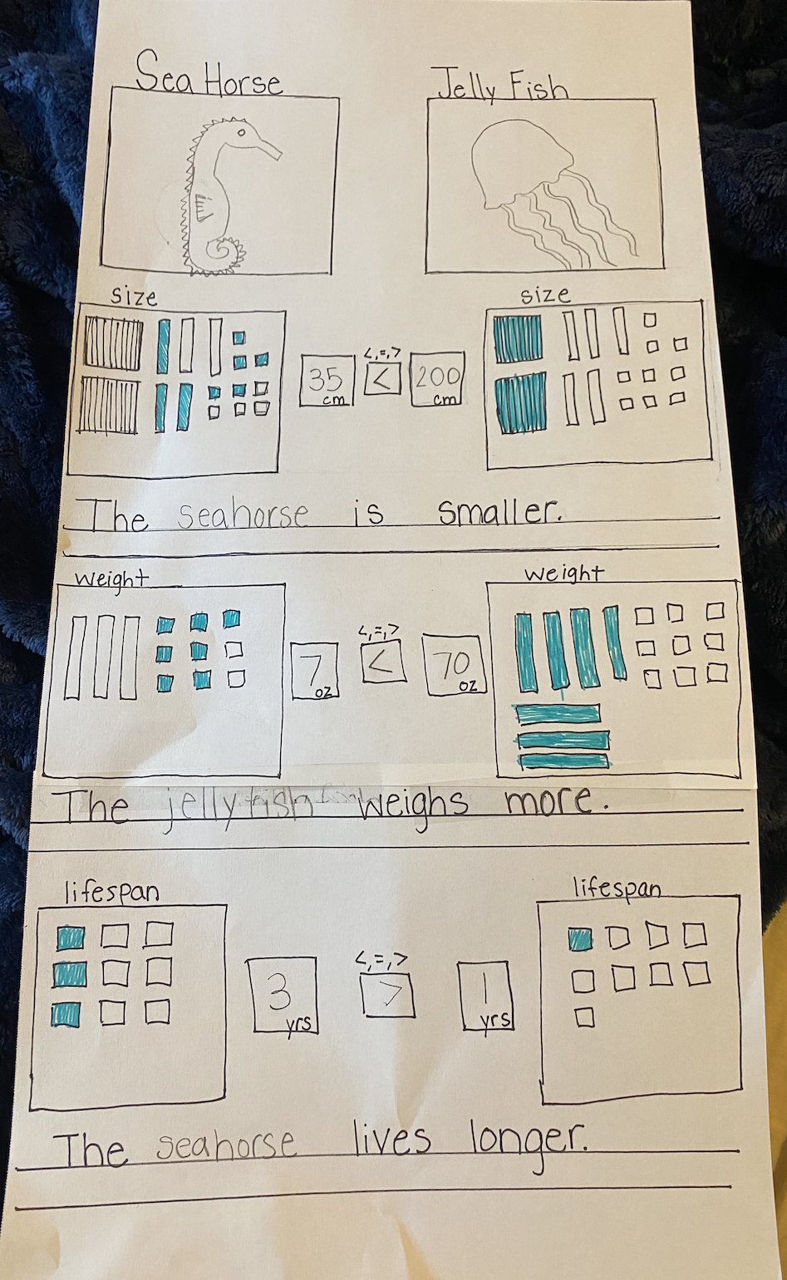
Interdisciplinary Performance Task cont.
Differentiation:
Above Grade Level:
To support students who are performing above grade level, copies of the poster outline can be made without pre-drawn base ten blocks to give the student the opportunity to draw the correct amount of base ten blocks on their own. Additionally, the writing prompts below each characteristic can be removed to give student a more challenging opportunity to write the full sentence on their own.
Below Grade Level:
To support students who are performing below grade level, copies of the poster outline can be made with the correct amount of pre-drawn base ten blocks so that the student can just color in all of the blocks without working to figure out how many to color in. Additionally, the writing prompt or numbers can be filled in for the student to trace instead of having the student write them out themselves.

Slide 45
Resources
Resources Used in this Math Unit | Additional Resources to Consider
Education.com Teaching Number in the Classroom Kids Academy Number Rock Jack Hartman Videos: -Count to 120 -Count by 10’s to 120 - https://study.sagepub.com/wrighttnc - 1st Grade Assessment Video | Prodigy (Student Math Games) National Council of Teachers of Mathematics (Also, https://www.nctm.org/classroomresources/)

